Slide 1
Senior Leader Briefing
Future Investments in U.S. Biodefense Capabilities

Slide 2

BLUF and Overview
Our nation has encountered varied and deliberate biological attacks over the last decades
Naturally occurring disease outbreaks like 2009 H1N1 flu and SARS pandemic (Cooley, 2013)
Natural disasters, bioterrorist attacks, and outbreaks of infectious diseases are the leading violators of our biodefense capabilities
The biotechnology industry should help to reinforce our nation’s biodefense capability to prepare and respond to bioterror threats
Notes:
Our nation has encountered varied and deliberate biological attacks over the last decades. Naturally occurring disease outbreaks like 2009H1N1 flu and SARS pandemic (Cooley, 2013). Natural disasters, bioterrorist attacks, and outbreaks of infectious diseases are the leading violators of our biodefense capabilities. The biotechnology industry should help to reinforce our nation’s biodefense capability to prepare and respond to bioterror threats

Slide 3
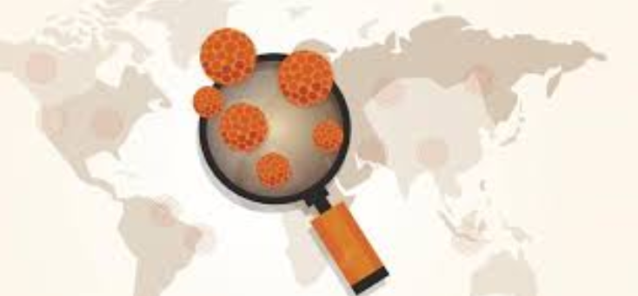
Key Biodefense Requirements
The major biodefense requirements include:
  Biodefense preparedness on emerging infectious diseases
  Strengthening emergency response capabilities, including decontamination efforts
  Prevention-related efforts (Whitehouse.gov, 2018)
Notes:
The United States needs to set standards for improved biodefense capabilities by adhering to the major requirements (Berger et al., 2018). These include; biodefense preparedness on emerging infectious diseases through accurate biomedical advanced research and development. It should also consider strengthening emergency response capabilities, including decontamination efforts, and take prevention-related efforts.

Slide 4
Continuation of Key Biodefense Requirements…
Biodefense preparedness on emerging infectious diseases.
Our biodefense industry must ensure preparedness through:
  Defining the root causes of emerging infections (Whitehouse.gov, 2018).
  It should continuously finance basic research and preclinical development activities for acute discoveries.
  There is a need for developing regulatory management plans, provide technical assistance, and help solve regulatory and scientific issues (Whitehouse.gov, 2018).
  Strengthen the pipeline of medical products, drugs, and devices that will safeguard the nation during an emergency.
Notes:
Emergency preparedness is a paramount tool for biodefense industry. The industry is mandated to define the root causes of emerging infections such as Ebola, and this will pave the way for the most accurate intervention. It should continuously finance basic research and preclinical development activities for acute discoveries (Whitehouse.gov, 2018). There is a need for developing regulatory management plans, provide technical assistance, and help solve regulatory and scientific issues affiliated with bioterror diseases. Reinforcing the pipeline of medical products, drugs, and devices is required to safeguard the nation during an emergency.

Slide 5
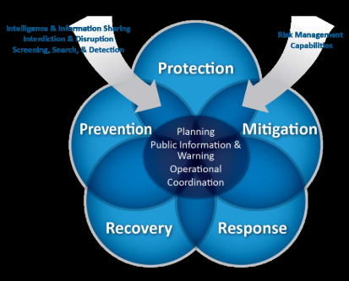
Continuation of Key Biodefense Requirements…
Strengthening emergency response capabilities, including decontamination efforts
  The federal biodefense efforts need to ensure a wide array of emergency preparedness
  Biodefense industry must ensure acute understanding of resource availability (Whitehouse.gov, 2018).
  Outline strategy to define the associated detection, preparedness and response
  Need for acute recovery for environmental decontamination through binding policies and protocols
Notes:
Strengthening emergency response capabilities, including decontamination efforts, is another key biodefense requirement. The federal biodefense efforts need to ensure a wide array of emergency preparedness by embracing the fact that many jurisdictions are shifting from infectious disease preparedness for high probability public health threats. There is a need for robust emergency response (Whitehouse.gov, 2018). Moreover, the biodefense industry must ensure acute understanding of resource availability as assign situational awareness. Biodefense industry must outline a strategy to define the associated detection, preparedness, and response while abiding by the need for acute recovery for environmental decontamination through binding policies and protocols.

Slide 6
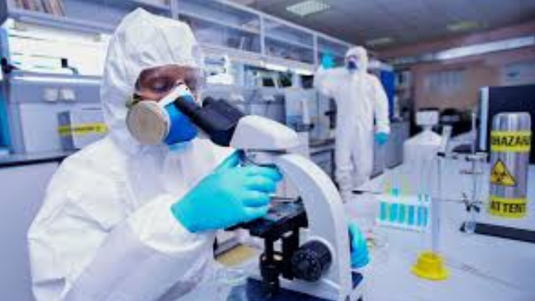
Prevention-related efforts
Biodefense agencies should help establish preventive norms to help prevent development, production in addition to the storage of dangerous biological weapons (Whitehouse.gov, 2018).
Future-oriented strategies should deepen investment in addition to the commitment to prevent bioterror attack.
There is a need to enlighten people on the risks of misusing biology by promoting education
Notes:
Prevention-related efforts are featured with varied aspects to undertake. To begin with, the US biodefense agencies should help establish preventive norms to help prevent development, production in addition to the storage of dangerous biological weapons (Whitehouse.gov, 2018). Future-oriented strategies should deepen investment in addition to the commitment to preventing bioterror attack. There is a need to enlighten people on the risks of misusing biology by promising education.

Slide 7
Overview and assessment of current U.S. biodefense capabilities and policies
The biodefense plan has launched new vaccines and other preventive measures against infectious diseases
There is effective national biodefense policies and strategies concerning immigration
There is effective implementation of the Affordable Care Act to ensure access to health insurance (Whitehouse.gov, 2018)
There is the acute establishment of Department of Human and Health Services
Increased bio-surveillance activities with technical support
Notes:
The current US biodefense industry has been endowed with acute dissemination of biosecurity to the entire nation (Whitehouse.gov, 2018). As evident, the industry has been endowed with biodefense plan which has encouraged launching of new vaccines and other preventive measures against contagious diseases. Effective national biodefense policies and strategies concerning immigration. Also, there has been effective implementation of the Affordable Care Act to ensure access to health insurance for all at-risk population in the US (DiEuliis, 2019). Acute establishment of Department of Human and Health Services has also paved the way for thorough implementation of biology and biotechnology strategies to safe humans. Increased biosurveillance activities with technical support have laid the foundation to detect, treat, and prevention of planned bioterror attacks.

Slide 8
Assessment of how current capabilities and policies meet key biodefense requirements
Current capabilities support the key biodefense requirements by:
Offering rapid response to limit the impact of big incidents (DiEuliis, 2019).
Ascertaining biodefense enterprise preparedness to alleviate the impacts of biodisaster
Enriching biodefense agency capabilities to prevent bio-incidences
Enabling risk awareness to support accurate decision making across the biodefense agencies
Facilitation of recovery strategies to enhance acute restoration of the society, the economy in addition to the environment after bio-incidences
Notes:
Current capabilities and policies played a core role by supporting the key biodefense requirements by offering rapid response to limit the impact of bioincidents to deter additional damages (DiEuliis, 2019). They have also ascertained biodefense enterprise preparedness to alleviate the impacts of bio-disaster through setting standards and availing all the required resources to enrich biosecurity while enriching biodefense agency capabilities to prevent biodefense. These capabilities have also enabled risk awareness to support accurate decision making across the biodefense agencies (Whitehouse.gov, (2018). There had been acute facilitation of recovery strategies to enhance acute restoration of the society, the economy in addition to the environment after bio-incident.

Slide 9
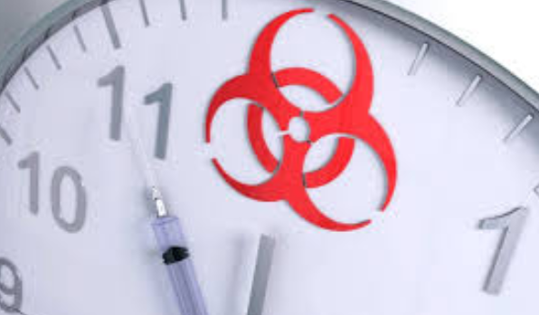
Options on ways to better meet your three key requirements
Ensuring biodefense preparedness on emerging infectious diseases
Focusing on emergency response capabilities, including decontamination efforts
Making prevention-related efforts
Notes:
The three biodefense requirements should be addressed by ensuring biodefense preparedness on emerging infectious diseases. Specialists should also stay focused on the on emergency response capabilities, including decontamination efforts. More importantly, making prevention-related efforts would pave the way to improving biodefense practices.

Slide 10
Recommendation for decision-makers
Biodefense agencies should:
Offering rapid response to limit the impact of bioincidents (Cooley, 2013).
Ascertaining biodefense enterprise preparedness to alleviate the impacts of biodisaster
Enriching biodefense agency capabilities to prevent bio-incidence
Notes:
Biodefense agencies should offer rapid response to limit the impact of bioincidents by ensuring information sharing, coordinated response operations, in addition to networking and coordination of effective public messaging.
Ascertaining biodefense enterprise preparedness to alleviate the impacts of biodisaster will enhance a strong public health infrastructure and ensuring acute risk communications (Cooley, 2013). Also, it is recommendable for the concerned agencies to enrich biodefense agency capabilities to prevent bioincident through funding for biological material, equipment, and degradation of technical capabilities. It is with no doubt that effective enactment of effective science and technology-based practices will pave the way for improved biodefense control.

Slide 11
Summation
Biosecurity is a leading challenge to the United States:
Our nation has encountered varied and deliberate biological attacks over the last decades.
Naturally occurring disease outbreaks like 2009H1N1 flu and SARS pandemic (Cooley, 2013).
Natural disasters, bioterrorist attacks, and outbreaks of infectious diseases are the leading violators of our biodefense capabilities.
The U.S. Biodefense should invest in improving Biosurveillance Capabilities and Laboratory Networks.
It should support Risk Assessments and Characterizing Threats (Rudolph et al., 2019).
The national security team should ensure support on these core investment decisions.
Notes:
Biosecurity is a leading challenge to the United States. As evident, our nation has encountered varied and deliberate biological attacks over the last decades, facilitated by naturally occurring disease outbreaks like 2009H1N1 flu and SARS pandemic (Cooley, 2013). Natural disasters, bioterrorist attacks, and outbreaks of infectious diseases are the leading violators of our biodefense capabilities. The U.S. Biodefense should invest in improving Biosurveillance Capabilities and Laboratory Networks. It should support Risk Assessments and Characterizing Threats. The national security team should ensure support on these core investment decisions.

Slide 12
References
Berger, K., DiEuliis, D., Meyer, C., & Rao, V. (2018). Roadmap for biosecurity and biodefense policy in the United States. J Health Security. In press. Google Scholar.
Cooley, T. (2013). Biodefense Preparedness Key for National Public Health. Retrieved from https://www.biotech-now.org/health/2013/07/biodefense-preparedness-key-for-national-public-health
DiEuliis, D. (2019). Key National Security Questions for the Future of Synthetic Biology. Harv. Envtl. L. Rev., 43, 127.
Whitehouse.gov, (2018). National Biodefense Strategy. Retrieved from https://www.whitehouse.gov/wp-content/uploads/2018/09/National-Biodefense-Strategy.pdf

